Slide 1
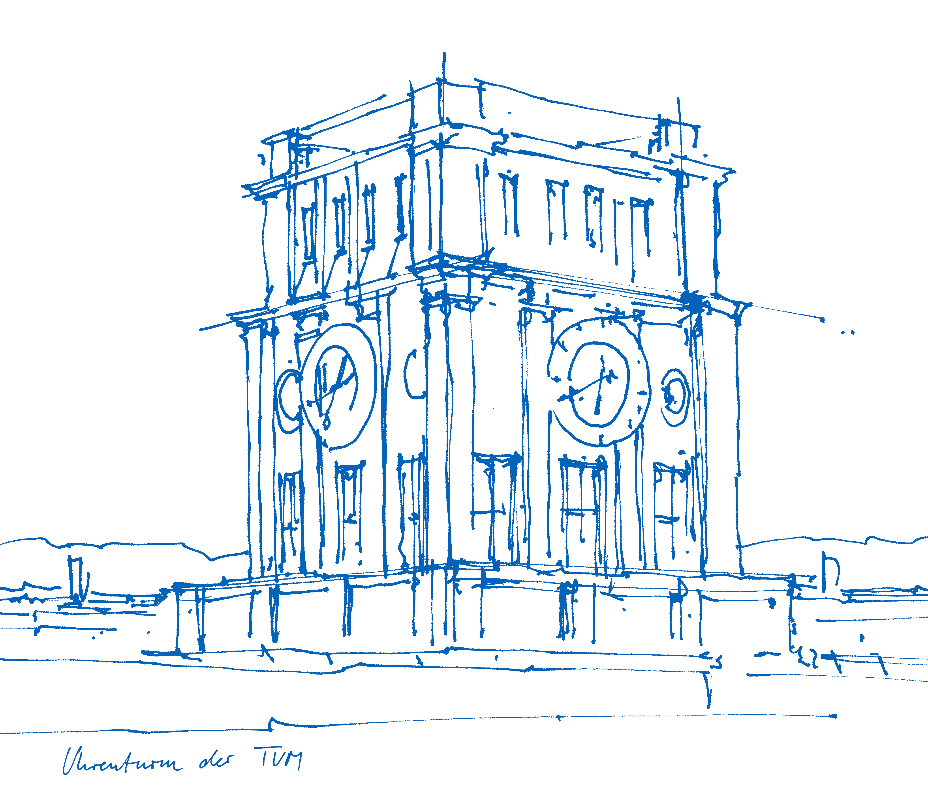
Exploring near-cost optimal alternatives for an intertemporal model of the German power system
Ilsu Kazkayasi
Technical University of Munich
Munich, 06 April 2020
Midterm Presentation Master's Thesis
Supervisor: Soner Candas

Slide 2
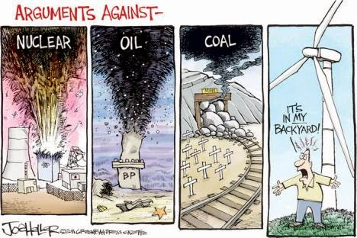
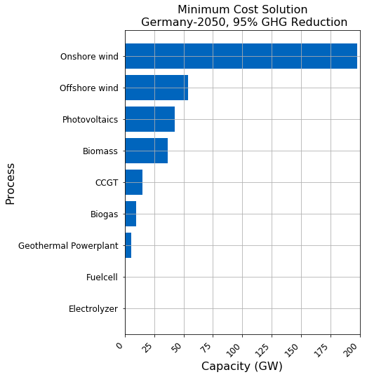

What is the point?
Notes:
First I want to start with motivation of my study
Why it worths studying this topic, what is the point
Classical cost optimization of an energy system returns a single cost optimal solution.
However long term investment decisions of an energy systems can not be made purely cost driven
There are many other criterias that remain uncaptured by the model
For example, social acceptance, scale of infrastructure projects, complexity and scale of the system itself,
Those criterias can be counted as structural uncertainties of the model
In addition to that, input parameters to the model are highly uncertain by nature
Long term prediction of Cost of technologies, fuel prices, load profile
As an end effect ,Real world transitions are usually more costly than modelled cost optimal solutions
For this reasons it is important to analyse near cost optimal alternatives of an energy system.
But what exactly near cost optimal alternatives
------------------------------------------------------------------------------------------------------------------------------------------------
Long term investment decisions are not purely cost driven. Many not easy to model criterias also drive decision making process - Complexity of the power system, fuel price predictions, social acceptance of different power technologies, scale of infrastructure projects and many other policy drivers are difficult to quantify hence remain un-captured by the model. Real world transitions usually more costly than modeled cost optimal solutions - Input parameters and structural assumptions lead to significant uncertainties of the model outcome.

Slide 3
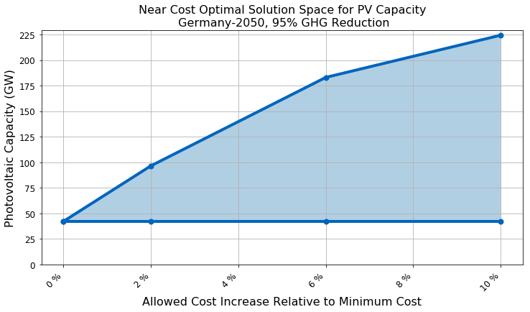
Near cost optimal alternatives
Notes:
- Near Cost Optimal alternatives are similar costly but sub cost optimal alternative solutions to cost optimal solution.
- In my study I utilize Modelling to Generate Alternatives methodology to study near optimal space of German power system.
In this methodology cost optimal solution is used as an anchor point to explore the surrounding decision space
In this graph this point is PV capacity given by the cost optimal solution as we diverge from cost optimum we see investment flexibility increases. 2% cost increase gives almost 50 GW flexibility in PV capacity investment
So why modeling tio generate alternatives
MGA helps to
Observe technologically diverse but similar costly solutions
Offers alternative transition pathways to meet unmodelled criteria like social exceptance for example
Evaluate the stability of cost optimal solution , here we seeoffered PV capacity by cost optimum solution is not stable at all
Show persisterent long term investment decisions ,again here we can say that even with 15% cost increase it is not possible to retrackt from PV technology completely
Now as we discussed about the methodology applied lets talk about the novel point. W
What is the novel point of this study?
----------------------------------------------------------------------------------------------------------------
-

Slide 4
What is the novel point?
Studies that apply modeling to generate alternatives (MGA) to energy system models.
Notes:
Here you see a list of studies that apply Studies that apply modeling to generate alternatives (MAG) to energy system models.
To my knowledge, my study is the first to utilize MGA for an intertemporal model of German power system.
I am going to analyze the period from 2020 to 2050 with total of 4 different modelled years.
The model will also consider progressive GHG mitigation goal defined by the German authorities.
To put it in one sentence
Goal of my thesis is to explore near-optimal, intertemporal investment alternatives to German power system model while sticking to long term emmission goals of Energiewende.
Hmm! now probably you are asking yourselves what is the deal with intertemporal?

Slide 5
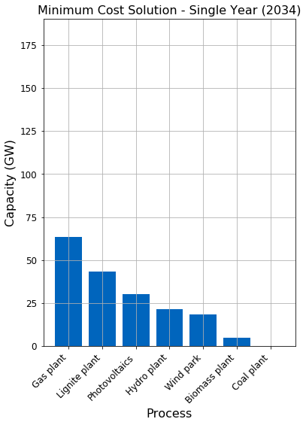
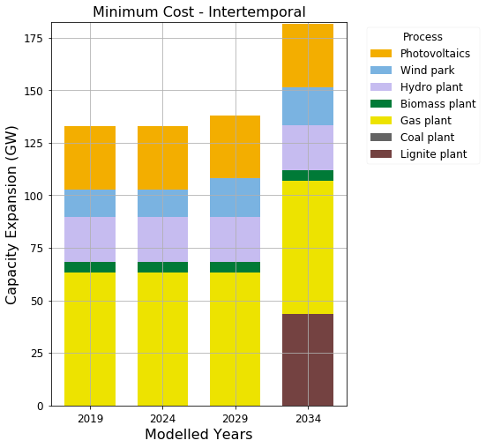
What does an Intertemporal model mean?
Notes:
Well, Intertemporal models analyse the development of the power system through a modeling horizon.
They give the solution as snapshots of the transition across multiple years
And plus they consider the investment dependencies between modelled years
On the left side you see a single year solution, which gives cost optimum for 2034
On the right side you see intertemporal solution of same input file with 4 different moddelled years from 2019 to 2034.
In the latter it is possible to observe how the transition will look like through years.
Also it is possible to define a cummulative co2 budget instead of a specific limit for single years.
As we are finished with terminology lets take a look at the application procedure
--------------------------------------------------------------------------------------------------------
In addition to giving a single optimal end solution to the optimization problem, it gives the snapshots of the transition across multiple years.
with consideration of investment dependencies between modeled years. (intertemporal single year dummy graph)
I am goingto model German power system from 2020 to 2050 with modelled years 10 years apart.

Slide 6
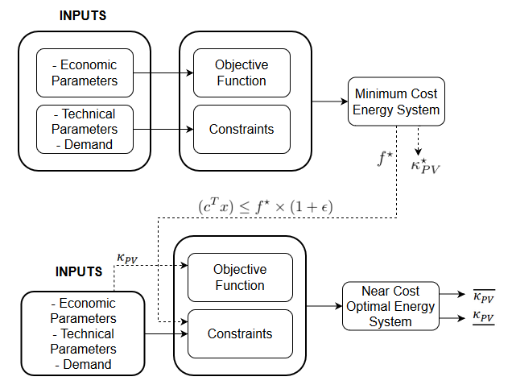
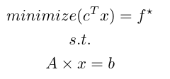
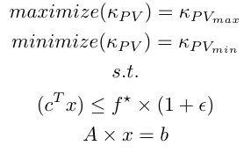
Application
Notes:
I applied MAG on „URBS“ , which is a linear energy system modelling framework
URBS already has working intertemporal modules, however it is originally capable of doing only classical optimization.
In order to apply MAG with urbs I created an independent module that analyses near cost optimal alternatives
Which first runs the model with a classical cost optimization.
Minimum cost found is applied to the model as a new constraint with a small percentage increase
A set of generation capacities are choosen to be objected to optimization , here only PV capacity is choosen but program is designed to accept also more than one
A new objective function is formulated to first maximize then minimize objected generation capacities
As outcome a range of capacity is obtained for the same cost
Some other capabilites of the new feature:
It takes a list of slack values and applies them in succession automatically
For multi node models it is possible to choose optimization regions independently for each optimized generation technology.
Region selection made available also for the original objectives
Now it is time to see the first results ☺
------------------------------------------------------------------------------------------------------------------------------------------------------------------------------------
MGA methodology is applied to linear energy system modelling framework 'URBS' in order to explore near cost optimal alternatives for german energy system.
-Neden cünkü hali hazirda intertemporal modülleri cvar
Urbs finds the minimum
In order to apply MGA to URBs model formulation needs to be extended.
Implementation sequence of MGA on cost optimizing energy system model follows as below:
First original model is run to find the cost optimal solution of the system.
This solution is going to be the anchor point to explore near-by solution space.
Then minumum
This percentage increase is called slack , can be defined flexibly by user prior to optimization and usually in the range of 1% to 10%
Objective function formulated to first minimize then maximize the generation capacity of a subset of generation technologies at specified model regions.
New objective also subjected to all constraints from original model
system cost is introduced into the model as a new constraint with a small percentage increse cost energy system to satisfy given demand timeseries for a given modelling horizon.

Slide 7
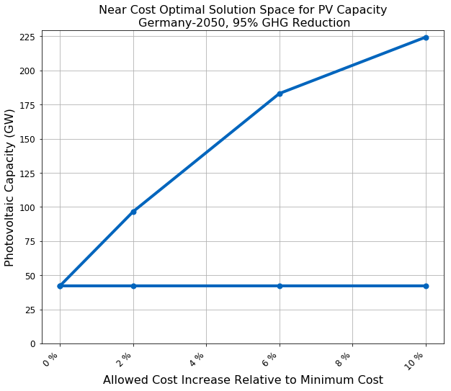
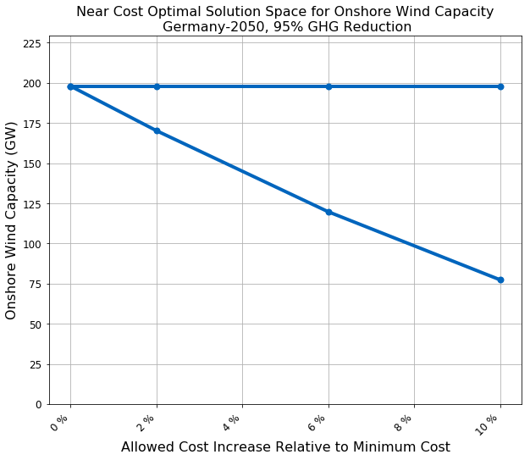
Results – Germany, Single Year, 2050
Notes:
I have the input file for 2050 German power system from a former student‘s master Thesis
I analyzed this input file my new module
In the first graph PV capacity is subjected to optimization
and in the second graph onshore wind capacity is subjected
As we see ,
for current ghg mitigation goals it is not possible to imagine a power system for germay either without onshore wind or PV technologies
However as we diverge from the minimum cost, investment flexibility of technologies improves drastically.
PV capacity has a greater range of flexibility as also pointed out by other similar studies

Slide 8
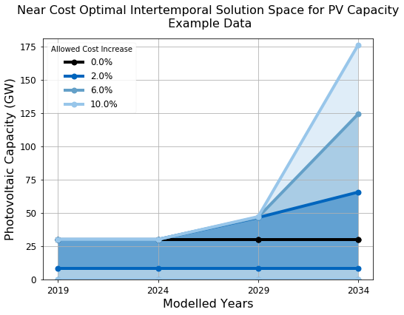
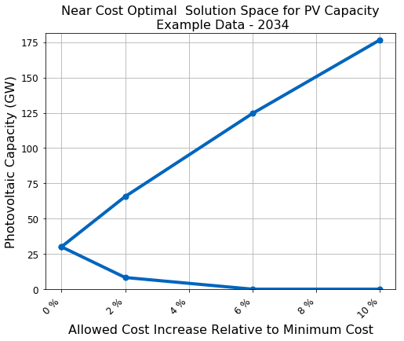
Results – Intertemporal Example from GitHub
Notes:
Here is an intertemporal solution.
Example input files from urbs git hub repository is used for this analysis
On left side only solution of the last year is shown and
on the right side you see development of the solution through years
These graphs are only for pv capacities, which is the objected technology

Slide 9
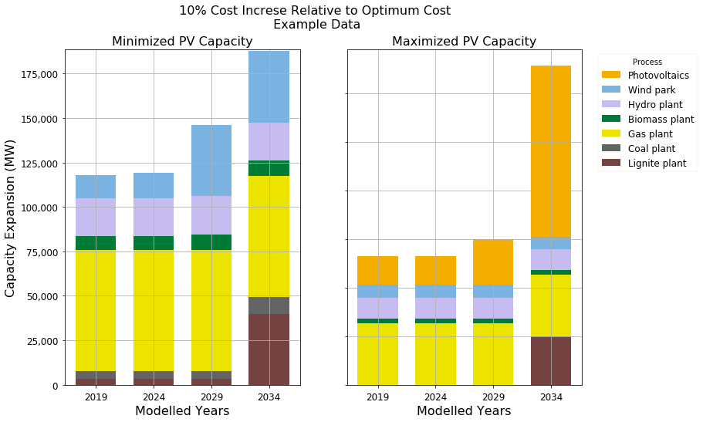
Results – Flexibility of the system
Notes:
Here is another view of the same solution this time only for 10 percent cost increse
On the left side you see how system will evolve when pv capacity is subjected to minimization
On the right side PV capacity is subjected to maximization
Here we can interpret that wind energy and PV are substitutes of each other
Minimization of one will cause increase of the other due to ambitious GHG reduction goals.

Slide 10
Next steps…
Input File for 2020 and 2050
Interpolation for 2030 and 2040
Runing for entire time horizon and multiple cost increases
Interpretation of results
Documentation of near optimal feature as a new module for urbs
Notes:
Lastly I want to talk about the next steps I plan to achieve during course of my thesis

